Slide 1




WEB SCRAPING AND PRODUCT ANALYSIS
Web scraping for price and rating comparison
CSE
ADITYA UNIVERSITY

Slide 2

Our Members
M.AKSHAYA
TEAM LEAD
K.S.KRISHNA
DATA & TECH LEAD
P.JAGANNADHA
IMPLEMENTATION LEAD
T.YEGHNA
Q&A AND STRATEGY LEAD

Slide 3
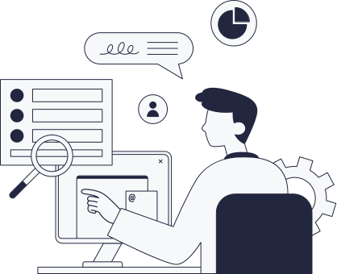
Introduction
  Web Scraping
Web scraping is the process of automatically collecting data from websites using software instead of manually copying information.
  Product Analysis
Product analysis is the process of studying product information such as prices, ratings, availability, and reviews to identify trends and support better business decisions.

Slide 4
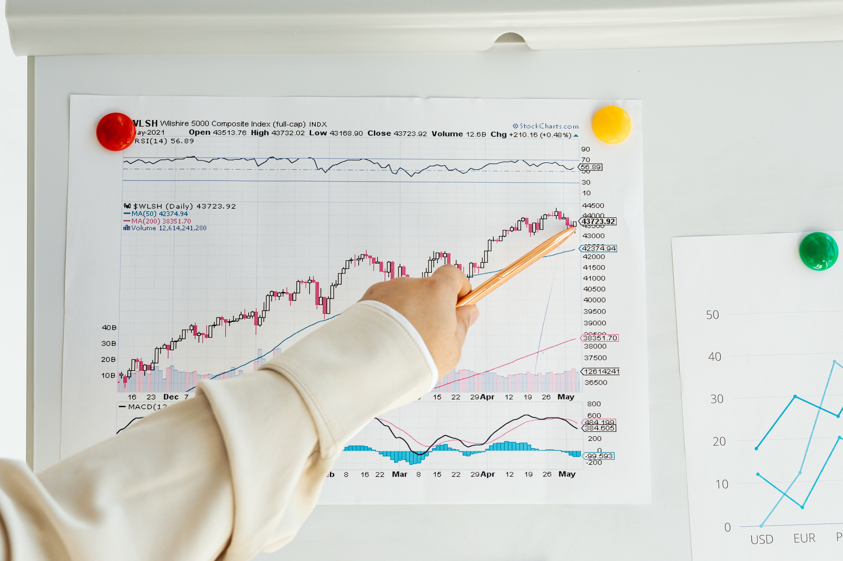
Problem Statement
Many e-commerce websites contain valuable product information, but manually collecting and analyzing this data is Time-consuming,Error-prone,Difficult to update regularly
Our project automates data collection and analyzes products efficiently.

Slide 5

Objectives
  Collect product data automatically.
  Store structured information.
  Clean collected data.
  Analyze product information.
  Visualize insights.
  Save time and improve accuracy.

Slide 6

Existing Method
  Open multiple product pages manually.
  Compare price and rating one by one.
  The process is slow and repetitive
Proposed Method
  Use Python for scraping.
  Use Requests to fetch webpage HTML.
  Use Beautiful Soup to extract product data.
  Use Pandas to clean and organize data.
  Use charts to show findings.

Slide 7

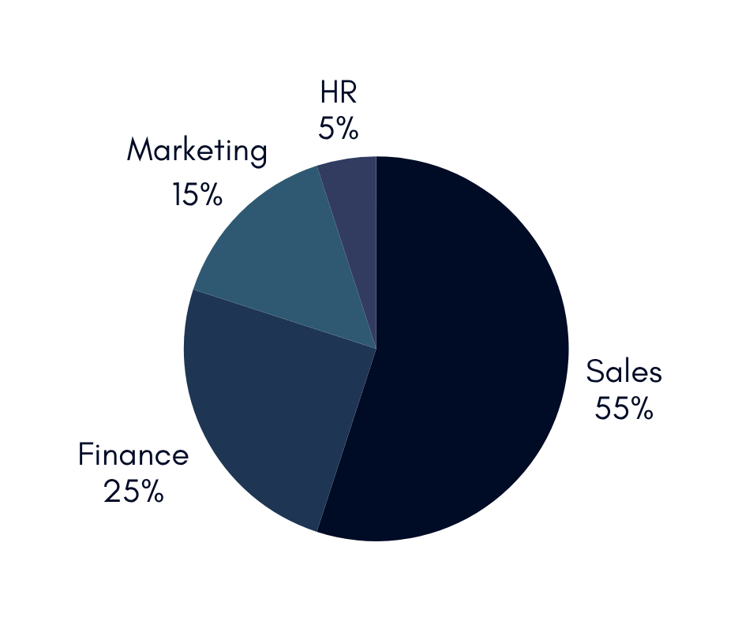
Data Source
Website Used: Books to Scrape
Data Collected
  Product Name
  Price
  Rating
  Availability
  Product Category

Slide 8

Tools and Technologies
TOOLS | PURPOSE
Python | Programming Language
REQUESTS | Retrieve web pages
BeautifulSoup | Extract HTML data
Pandas | Data cleaning and analysis
Matplotlib | Data visualization
CSV | Store extracted data
VS Code / Jupyter Notebook | Development environment

Slide 9
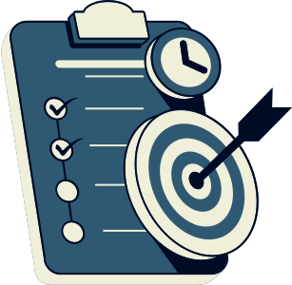
Methodology
Project Methodology
  Select a public website.
  Download the webpage using Python.
  Parse HTML using BeautifulSoup.
  Extract required product details.
  Clean and organize the collected data.
  Store the data in CSV format.
  Analyze the dataset using Pandas.
  Create visualizations using Matplotlib.
  Present the final results.

Slide 10
Implementation
The project begins by connecting to the selected website using Python Requests. The HTML content is parsed using BeautifulSoup to extract product information such as product name, price, rating, and availability.
The extracted data is stored in a CSV file and analyzed using the Pandas library. Charts are generated using Matplotlib to visualize the collected information.

Slide 11

Expected Results
  Clean CSV dataset.
  Product comparison tables.
  Bar charts and scatter plots.
  Insights about price and rating patterns.

Slide 12

Limitations, Ethics, Future Scope
  HTML structure may change.
  Some data may be missing.
  Only a limited number of pages may be collected.
  Scraping must follow website rules and robots.txt.
  Future scope: more websites, dashboard, automation.

Slide 13

Conclusion
  Web scraping helps collect product data automatically.
  Data cleaning and analysis convert raw data into useful information.
  Charts make product comparisons and trends easier to understand.
  The project provides practical experience in Python and data analysis.
  Future improvements may include more websites, dashboards, and automated updates.

Slide 14
Thank You

